Slide 1
Agile Methodology
Jorge Fernando Moreno Jacob
Southern New Hampshire University

Slide 2
Agenda
01
Explaining Agile Roles
Slide 03
02
Explaining Agile Phases
Slide 06
03
Describing Waterfall Model
Slide 08
04
Waterfall or Agile Approach?
Slide 11

Slide 3
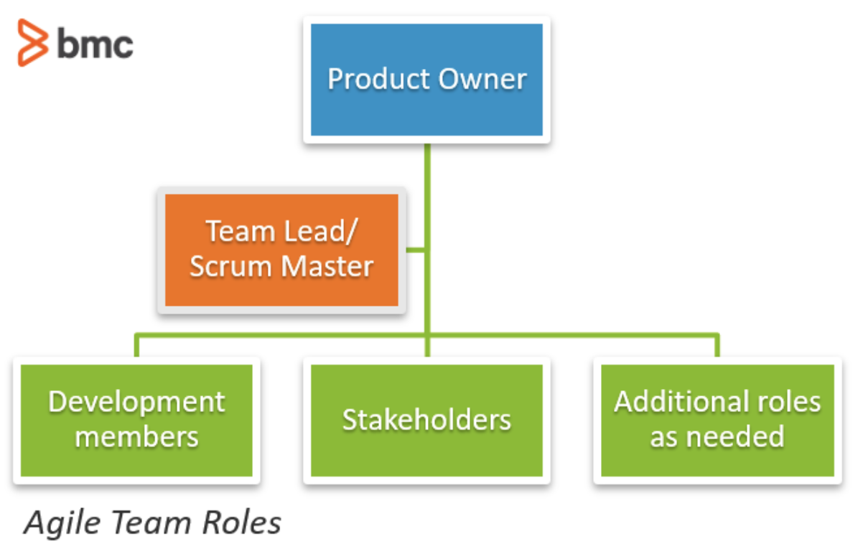
Agile Roles
Agile roles are essential for establishing clear responsibilities, fostering collaboration, and ensuring alignment with project goals. This structure enables teams to adapt quickly, maintain accountability, and consistently deliver value, driving overall efficiency and success.
Source: BMC Software, 2025

Slide 4
Agile Roles
Product Owner
Scrum Master
Developers
Responsible for maintaining and prioritizing the Product Backlog based on client needs
Facilitates communication, supports the team, and ensures the Scrum framework is followed.
Responsible for designing, coding, testing, and delivering the website.
Source: BMC Software, 2025

Slide 5
Additional Agile Roles
Stakeholders
Project Managers
Additional Roles as needed
Who influences or is affected by the product, providing input to guide development toward business goals, user needs, and team challenges.
Guides the team in delivering customer value by fostering collaboration, adapting to changing priorities, removing obstacles, and ensuring alignment with Agile principles.
Technical and domain experts
Independent testing and audit team
Architect Owner
Source: BMC Software, 2025

Slide 6
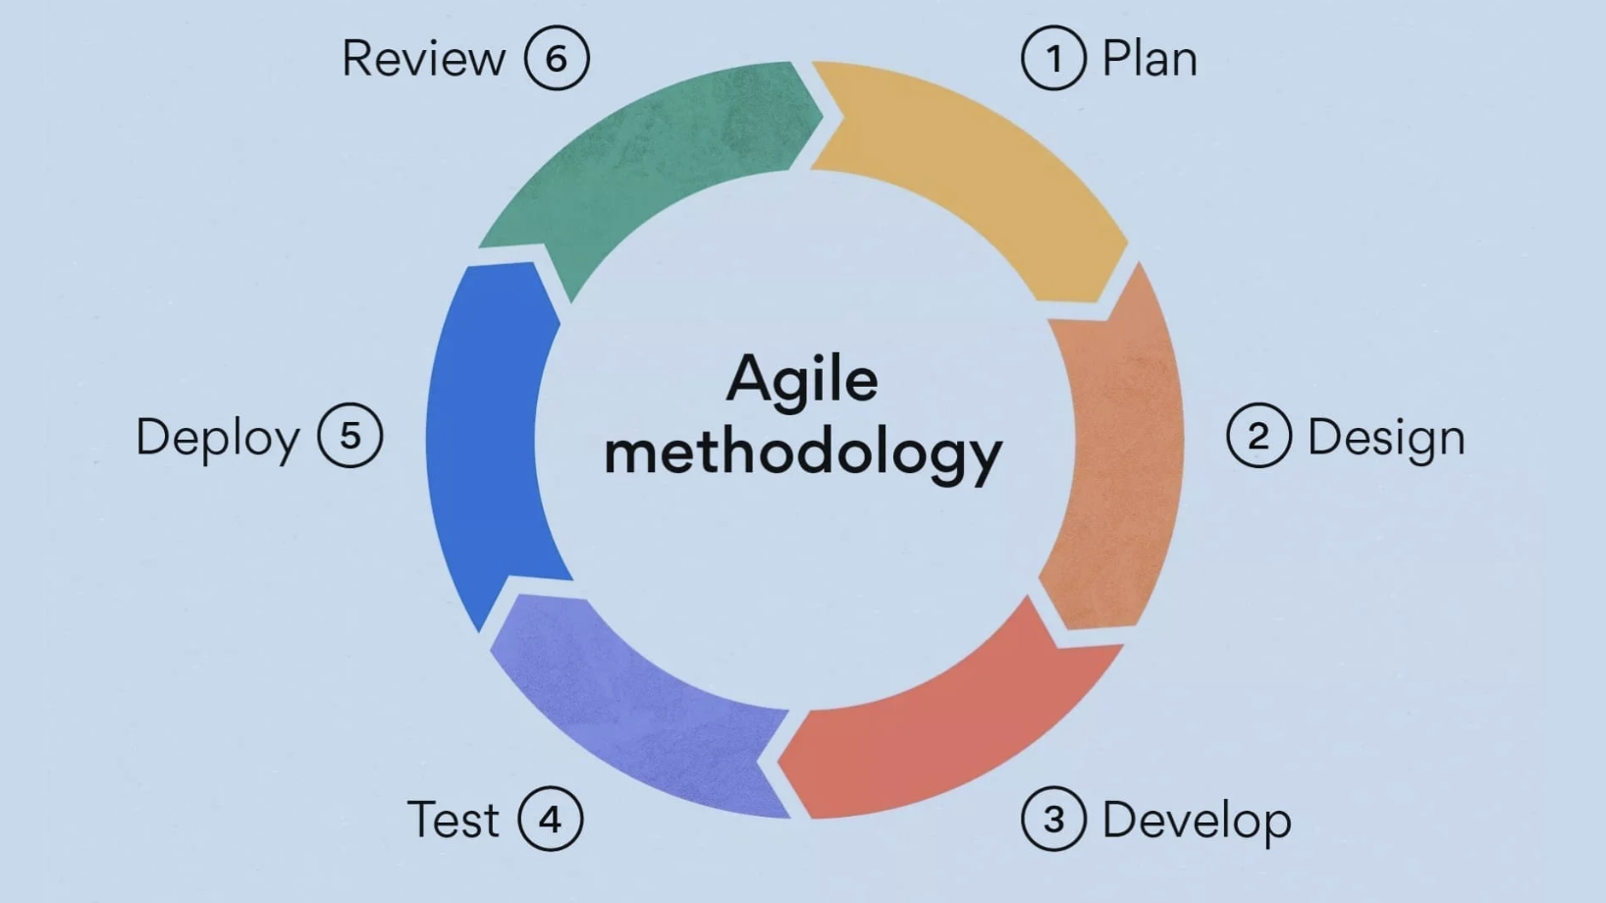
phases

Slide 7
Agile Phases
Requirements & Concept
Sprint Planning
Collaborative Design & Dev
Create & Implement
Review & Monitor
Define the project’s vision, goals, and scope, ensuring all stakeholders share the same understanding.
Break work into prioritized sprints, deciding which user stories and tasks will be completed.
Design, code, and refine features with continuous feedback from the team and stakeholders.
Build and test small increments, integrating them regularly to maintain quality.
Gather feedback, evaluate performance, and identify improvements for future sprints.
Estanislao H. 2025

Slide 8
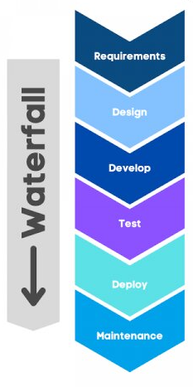
What about the Waterfall Methodology?
Under the Waterfall model, software development proceeds through a linear sequence of phases (requirements, design, implementation, verification, and maintenance) with each stage needing to be completed before the next begins. This rigid structure makes it difficult to revisit earlier phases once finalized, meaning any mistakes or changes emerging later can be costly to fix
Atlassian
Source: Datavalley Inc, 2023

Slide 9
Waterfall vs. Agile – How Development Would Differ?
Confidential

Slide 10
Different Process:
An example
Had we used Waterfall instead of Agile for SNHU Travel:
We would have needed to finalize all requirements upfront, with no opportunity to tweak features like Filter Top Destinations based on mid-sprint feedback.
Testing would occur only after coding was completed, causing issues to be caught late in the process (a stark contrast to Agile’s early, continuous testing).
Any change requested mid-course, such as refining the Personalized Travel Suggestions, would have triggered a costly and time-consuming formal change control process.
Atlassian, 2025.

Slide 11

Factors favoring Agile Methodology
Flexibility & Adaptability Agile allows ongoing changes and adjustments based on evolving feedback and stakeholder needs. Agile teams work in short, iterative sprints, which supports fast delivery and quality improvement.
Continuous Customer Collaboration Regular involvement of the customer during development helps ensure the final product meets real needs, reducing the risk of delivering irrelevant or outdated features.
Faster Feedback Loops & Risk Reduction Frequent iterations and releases help catch issues early and keep development aligned with user expectations. This iterative rhythm lowers overall project risk.
Empowered, Cross‑Functional Teams Agile promotes shared ownership of work. This team-based model typically leads to better accountability, innovation, and adaptability.
Confidential

Slide 12

Waterfall Methodology: When it might be
a better fit
Comprehensive Documentation & Control Extensive upfront documentation helps in environments where formal records and change control are required, such as regulated industries.
Effective for Stable, Low-Change Projects When scope, requirements, and resources are well-defined and unlikely to shift, Waterfall’s structured approach minimizes scope creep and provides clarity for all team members.
Lower Risk for Teams with Less Agile Experience Waterfall's predictable, phase-by-phase structure can be easier for teams without prior Agile training to follow and maintain discipline in delivery.
BMC Software, 2023

Slide 13
Refe
rences
BMC Software. (2025, July 18). Agile roles & responsibilities. BMC Blogs. https://www.bmc.com/blogs/agile-roles-responsibilities/
Estanislao, H. (2024, July 22). Understanding Agile Methodology Steps in Project Management and Software Development. Rosemet. https://www.rosemet.com/agile-methodology-steps/
Datavalley Inc. (2023, January 31). Waterfall vs Agile: Which is better for you and why? LinkedIn. Retrieved from https://www.linkedin.com/pulse/waterfall-vs-agile-which-better-you-why-datacademy-cloud
Atlassian (2025). Waterfall methodology. In Atlassian Agile Coach. Retrieved August 13, 2025, from https://www.atlassian.com/agile/project-management/waterfall-methodology
BMC Software. (2023, September 28). Agile vs waterfall: Key differences, pros & cons. BMC Blogs. https://www.bmc.com/blogs/agile-vs-waterfall/

